Slide 1
User Research & Testing

Slide 2

0. INTRODUCTION
Notes:
Accessibility isn’t just about inclusion, it’s also a real business opportunity. It can help reach more users, improve SEO, and reduce development costs in the long run.

Slide 3
Summary
0. Introduction
1. Prepare yourself and control your environment
2. Create your test protocol and follow it
3. Analyze
4. Make a report

Slide 4

Understanding Usability Testing Through Usability of Fruits 🍌🍉
What is Usability Testing?
Observing Real User Behavior 👀: Watching how people interact with a product without guidance.
Identifying Pain Points ❌: Noticing where users struggle, hesitate, or make errors.
Gathering Insights for Improvement 🔄: Using findings to refine the design.
Source: https://youtu.be/3Qg80qTfzgU?feature=shared
Notes:
Here, we introduce the concept of user testing. To introduce this concept, we rely on the video that shows user tests using fruits.

Slide 5
Understanding Usability Testing Through Usability of Fruits
Lessons from Usability of Fruits Video
This playful experiment demonstrates usability principles by testing how easy (or difficult) it is to "use" different fruits:
Affordance Matters – Can users tell how to interact with it? (e.g., peeling a banana vs. a pineapple)
Expectation vs. Reality – Do people interact with it the way designers intended?
Feedback is Key – Does the product provide clear signals when used correctly or incorrectly?
Iterate & Improve – If something isn’t intuitive, how can it be redesigned to be more user-friendly?
How This Relates to Digital Products
Navigation = Peeling a Fruit: If users struggle to figure out how to "open" a feature, there’s a usability issue.
Error Prevention = Seedless Experience: Removing unnecessary obstacles leads to a smoother journey.
User-Centered Design = Choosing the Right Fruit: A great product matches user needs and expectations.
Notes:
We're debriefing here on the video we watched about user testing with fruits.

Slide 6
Lexicon
Persona: A fictional character based on real user data, representing a typical user’s goals, needs, behaviors, and pain points. Why use it? Personas help design teams stay focused on real users’ needs and expectations. Example: Emma, 32, beginner DIY enthusiast who wants to learn how to fix things at home.
User feedback: Information collected directly from users about their experience, needs, difficulties, or satisfaction. Why is it important? It helps improve products by identifying usability issues and validating design decisions.
Notes:
The purpose of this slide is to explain the main principles related to user feedback. We will discuss what personas are and what user feedback entails.

Slide 7
Before we start
What methods of collecting user feedback are you aware of? (post-its)
Notes:
Learners are asked to share the user feedback collection methods they know. We're in brainstorming mode.

Slide 8

How choosing user feedback method?
Data type
User knowledge
What's going on? (quantity)
Why is this happening? (quali)
Low
Important
Raised
What are they doing? (Behavior)
Emergency
Research type
Weak
What do they say? (Attitude)
Notes:
This slide is designed to use a flipped classroom approach. Ask participants to brainstorm and try to fill in the empty matrix based on what they know or what they imagine. Encourage them to think about:
When to use a quantitative or qualitative method.
When to observe user behavior or collect user attitudes.
How the user knowledge level influences their choice.
After the discussion, move to the next slide to compare their answers with the completed version

Slide 9
How choosing user feedback method?
Data type
User knowledge
What's going on? (quantity)
Why is this happening? (quali)
Low
Important
Analytics A/B Test Clickstream Unmoderated user tests Tree testing
Unmoderated user tests Clickstream Email survey
Cognitive walkthrough Expert evaluation Design Studio
Raised
Observation User tests
What are they doing? (Behavior)
Emergency
Research type
User Tests Interviews Observation Diary
Remote Users Tests A/B Test Prototype
Interview Design Studio Cards sorting Desirability testing
Weak
Survey Online User Feedback
What do they say? (Attitude)
Notes:
Here is the completed matrix. Compare it with what participants suggested in the previous exercise. Take time to explain each method and when it is most relevant, highlighting the differences between behavior and attitude, qualitative and quantitative data.

Slide 10

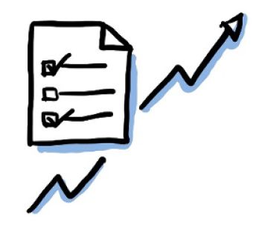

3 types of goals
Generative
Evaluative
Hybrid
Better understand the Persona to imagine solutions.
Analyze the interaction between the Persona and a particular product/service to improve it.
Better understand the Persona while analyzing the interaction (advanced)
Source: JEMS
Notes:
Here we explain the three types of user feedback. Generative feedback lets us brainstorm solutions based on user needs. Then, evaluative feedback gathers users' opinions on the solution. Finally, the hybrid mode is a mix of the two.

Slide 11
From opinion to facts
The best designers use facts to guide them. It is (more) difficult to question solid facts.
Sarah Doddy
Notes:
In a digital project, it's important to rely on user feedback rather than the opinions of the project team. https://lesjoiesducode.fr/quand-je-vois-les-utilisateurs-finaux-se-servir-de-lappli

Slide 12
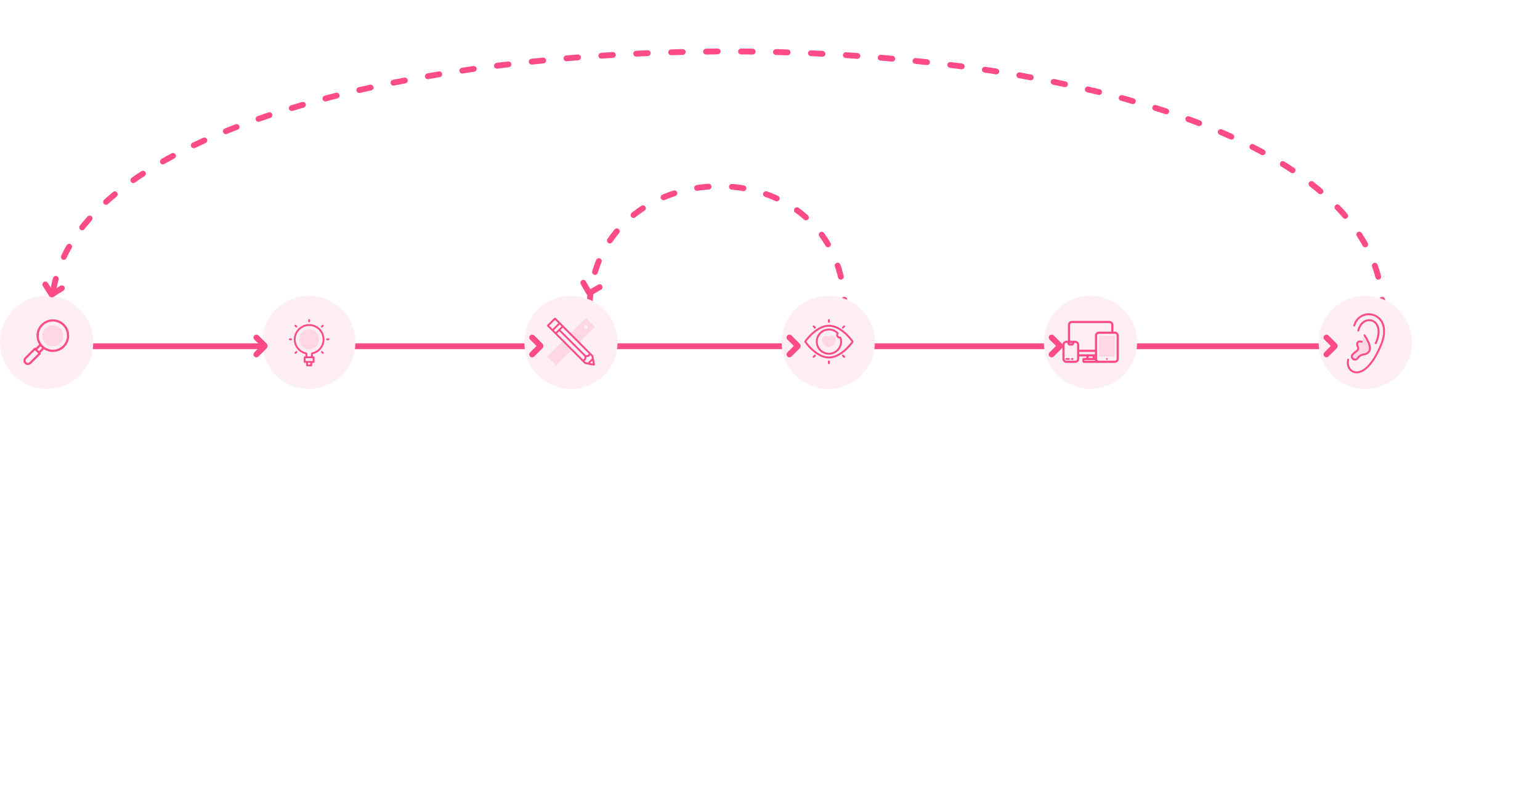
UX as a process
Improve
Iterate
Discover
Conceptualize
Design
Test
Develop
Listen
Stakeholders workshop Interviews Needs Questionnaires Benchmark …
Strategy workshop Design Studio Cards Sorting People …
Wireframing Prototyping Charters Expert analysis …
User testing Interviews Eye tracking A/B testing Tree Testing …
Expert analysis Cognitive assessment Accessibility check ...
Analytics Behavior statistics Quiz Newspapers Interviews Micro feedback …
Notes:
Testing is naturally the Design Phase and before Development. It's integrated in the iterative loop : make and learn.

Slide 13
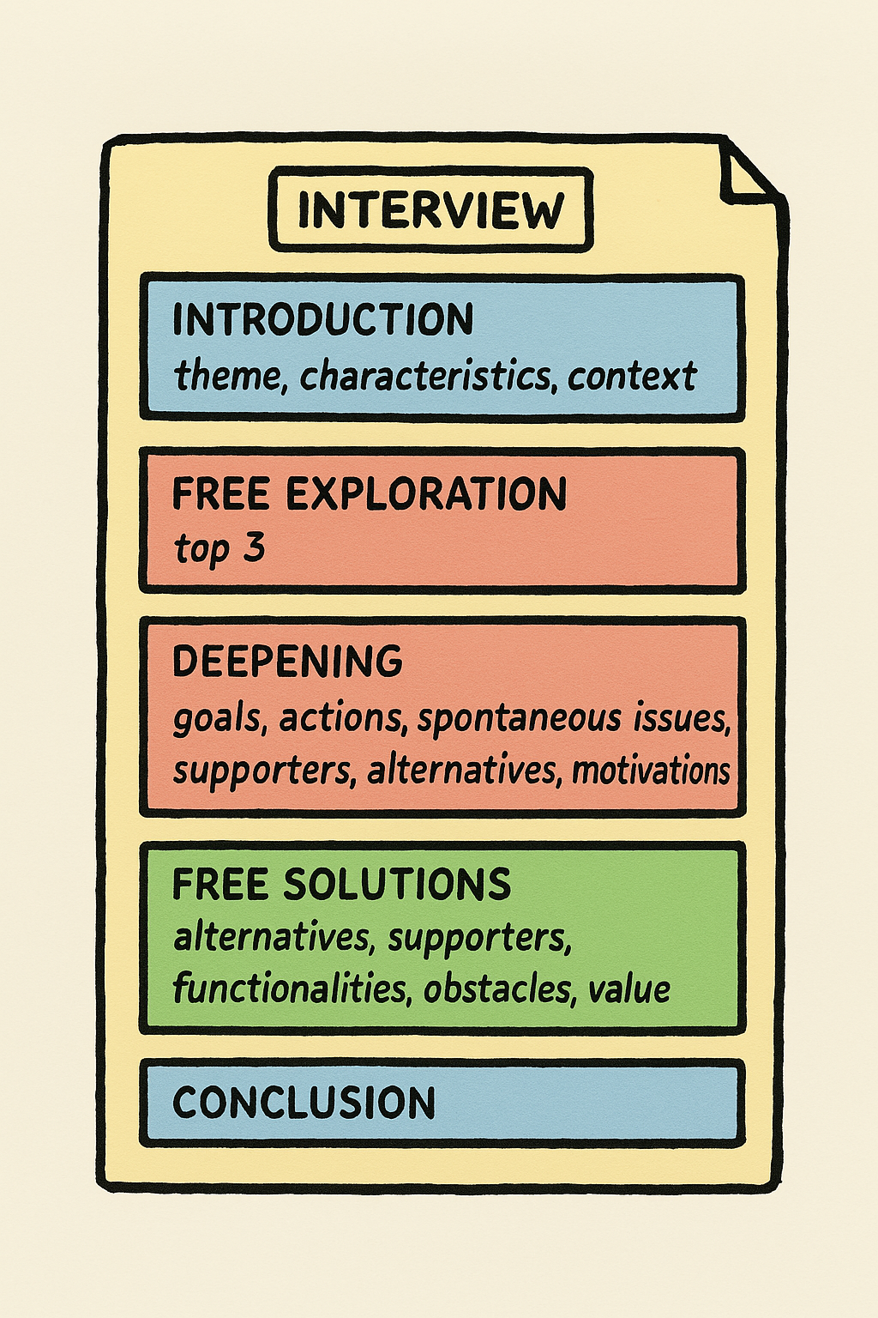
Some User Voice Techniques
Conducting the interview vs scripting. By focusing on the themes and hypotheses identified, while leaving room for free feedback from the participant.
Semi-directed interview. The questions are open for discussion, although they are structured around predefined themes.
Consensus document. The guide includes hypotheses to be validated, but is also an opportunity to ask the participant questions.
Framework for analysis. The structure of the guide itself makes it easier to take notes and analyze after research.
Source: JEMS
Notes:
Here we're talking about other methods of gathering user feedback, such as semi-structured interviews.

Slide 14
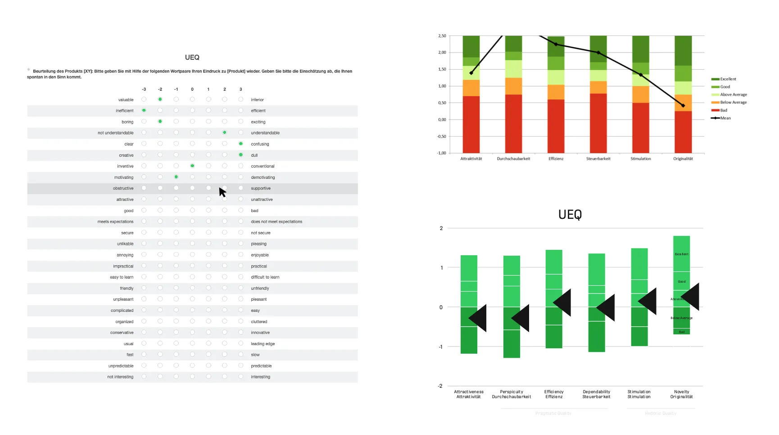
Standardize Questionnaire
Source: UX Design – Three very good standardized UX surveys for industrial use Available at: https://uxdesign.cc/three-very-good-standardized-ux-surveys-for-industrial-use-f8f1e628d475
Notes:
Other methods of collecting user feedback like standardized questionnaires.
UEQ
The User Experience Questionnaire is a well-known and widely discussed instrument. It measures six dimensions and is available in a long and short version. The dimensions are “Attractiveness”, “Perspicuity”, “Efficiency”, “Dependability”, “Stimulation” and “Novelty”. It contains 8 (short version) or 26 (long version) items as a semantic differential with a 7-point scale, so it has an adjective on the left and right side of each item. The result is a number between -3 and +3 for each of the six factors.
For every group, the arithmetic mean is calculated. The dimensions are evaluated against a large benchmark from 486 studies. Translations into more than 30 languages are available and provided on the UEQ website (EN, DE, ES, PT, TR, ID, CN, FR, IT, JP, NL, RU, ES, SL, SW, PL, GR, IN, PE, BG, CZ, ML, TH, DN, BN, IS, TA, Arab, BS, KR, FN, HU, NO, SL) along with online calculators and spreadsheet templates. A UEQ KPI extension and a modular extension UEQ+ are available as well. The benchmark consists of deviations for every of the 6 dimensions along 5 adjectives (bad, below average, above average, good, excellent). The duration for completion is about 4 to 8 minutes.

Slide 15
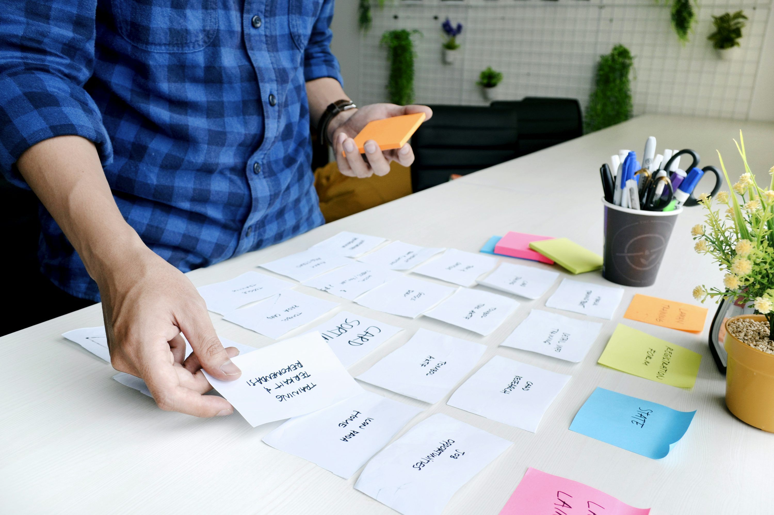
Card Sorting
Source : Explore Free Images, Wallpapers, & Backgrounds | Unsplash
Notes:
Here, we show other types of user feedback like card sorting. This slide illustrates different Card Sorting and Information Architecture exercises done during the UX process.
On the top left, a physical card sorting session where participants group content into categories.
On the bottom left, an example of a digital card sorting tool (OptimalSort).
On the right, we can see Affinity Mapping and Workshop outputs used to structure content and understand user needs. These exercises were part of the Understand & Plan phases to help build a relevant content structure.

Slide 16
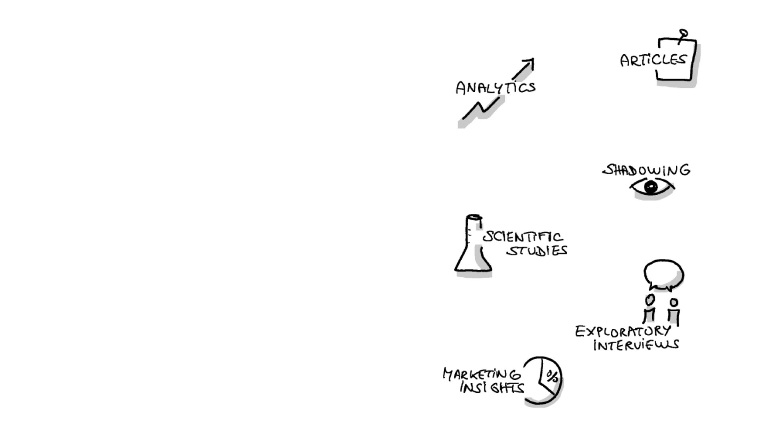
Understanding your users
No matter where you start, always start by observing and describing what you know about your users.
Source: JEMS
Notes:
Here, it is explained that, no matter the method we use, we always start by describing who the users are.

Slide 17

User Needs Investigation Canvas
1. Topic
2. Characteristics
3. Context
What is the main focused problem?
Who is the Persona?
Where and when is the Persona?
6. Pain Points
4. Goals
7. Motivations
12. Value for Persona
10. Solutions Features
What does the Persona face achieve the goals?
What does the Persona have to achieve?
What are the deep psychological needs of the Persona?
What are the pain relievers or gain creators for the Persona?
What are the functioning attributes of the product/service?
8. Supporters
Who/What contributes to helping the Persona today?
5. Actions
11. Solution Obstacles
How does the Persona achieve the goals?
What are the anxieties the Persona can feel regarding the solution?
9. Alternatives
What/who are the external existing solution to the problem?
Notes:
Canvas allows us to describe who the users are. We'll be doing exercises based on these canvases.
Topic Define the main problem or challenge the Persona is facing. It should be specific and focused on a concrete issue to investigate.
Characteristics Describe who the Persona is: demographic information, behaviors, skills, limitations, attitudes, etc. Helps to contextualize their needs and constraints.
Context Identify the circumstances in which the Persona encounters the problem: when, where, and in which situation(s) the issue occurs.
Goals Clarify what the Persona is trying to achieve. These are their explicit objectives related to the problem.
Actions List the steps or strategies the Persona currently uses to reach their goals, even if they are inefficient.
Pain Points Identify the main difficulties, frustrations, and obstacles the Persona experiences while trying to achieve their goals.
Motivations Describe the deep, sometimes unconscious, psychological needs or drivers that influence the Persona’s behavior and choices.
Supporters Determine who or what helps the Persona today to overcome their difficulties. It can be people, tools, services, or resources.
Alternatives List external solutions or workarounds that the Persona may already use or consider to solve the problem.
Solutions Features Identify the key attributes and functionalities of the product/service that can respond to the Persona’s needs.
Solution Obstacles Anticipate the anxieties, fears, or doubts the Persona may have about the solution you are proposing.
Value for Persona Explain what tangible and intangible benefits the solution will bring to the Persona. How will it relieve their pain points or create new value?

Slide 18
User Needs Investigation Canvas
1. Topic
2. Characteristics
3. Context
Mobile community navigation.
Particularly for their holiday trips.
In his car, in an unknown place, ….
6. Pain Points
4. Goals
7. Motivations
12. Value for Persona
10. Solutions Features
Encounter roadworks or traffic jams. Being stopped by the police. Take a difficult route. Arrive late. To get lost. Getting bored on the road. Network loss.
Arrive at your destination as quickly as possible. Discover routes. Enjoy the journey.
Competence - Efficiency. Security - Control.
Most reliable, community-based data. Free.
Existing Automatic data sharing. Manual warnings. Notification when to leave. Disruption notifications. Automatic route recalculation. Suggested discovery itinerary. Disruption notifications.. To be investigated Notification when to leave.
8. Supporters
Possible passengers. Other motorists. Road safety.
5. Actions
11. Solution Obstacles
Identify a route. Stay informed of road disruptions.
Putting yourself in danger by checking your phone. Pay.
9. Alternatives
Paper map, radio. Built-in GPS. Google Maps.
Notes:
This canvas is an example based on Waze, the mobile community-based navigation app. The investigation focuses on the specific user needs, pain points, motivations, and obstacles related to real-time navigation, particularly during holiday trips or in unfamiliar places.

Slide 19
Exercise
UNIC Canvas
Instructions: Fill in the UNIC Canvas based on a Persona related to the Do It Yourself context. Identify their needs, goals, obstacles, and possible solutions when doing a DIY project.
Time: 15 minutes
Format: Individual or small group work
Notes:
In this exercise, participants will apply the UNIC Canvas to a specific context: Do It Yourself (DIY). They should imagine or choose a Persona who is engaged in a DIY project and reflect on their experience:
What is their goal when starting a project?
What difficulties do they encounter?
What motivates them?
What external help or solutions do they use?
This helps participants practice user need investigation in a concrete, everyday scenario. At the end of the exercise, debrief by asking a few participants to share their canvas and highlight common patterns or surprising insights.

Slide 20
1. Prepare yourself and control your environment
Notes:
Accessibility isn’t just about inclusion, it’s also a real business opportunity. It can help reach more users, improve SEO, and reduce development costs in the long run.

Slide 21
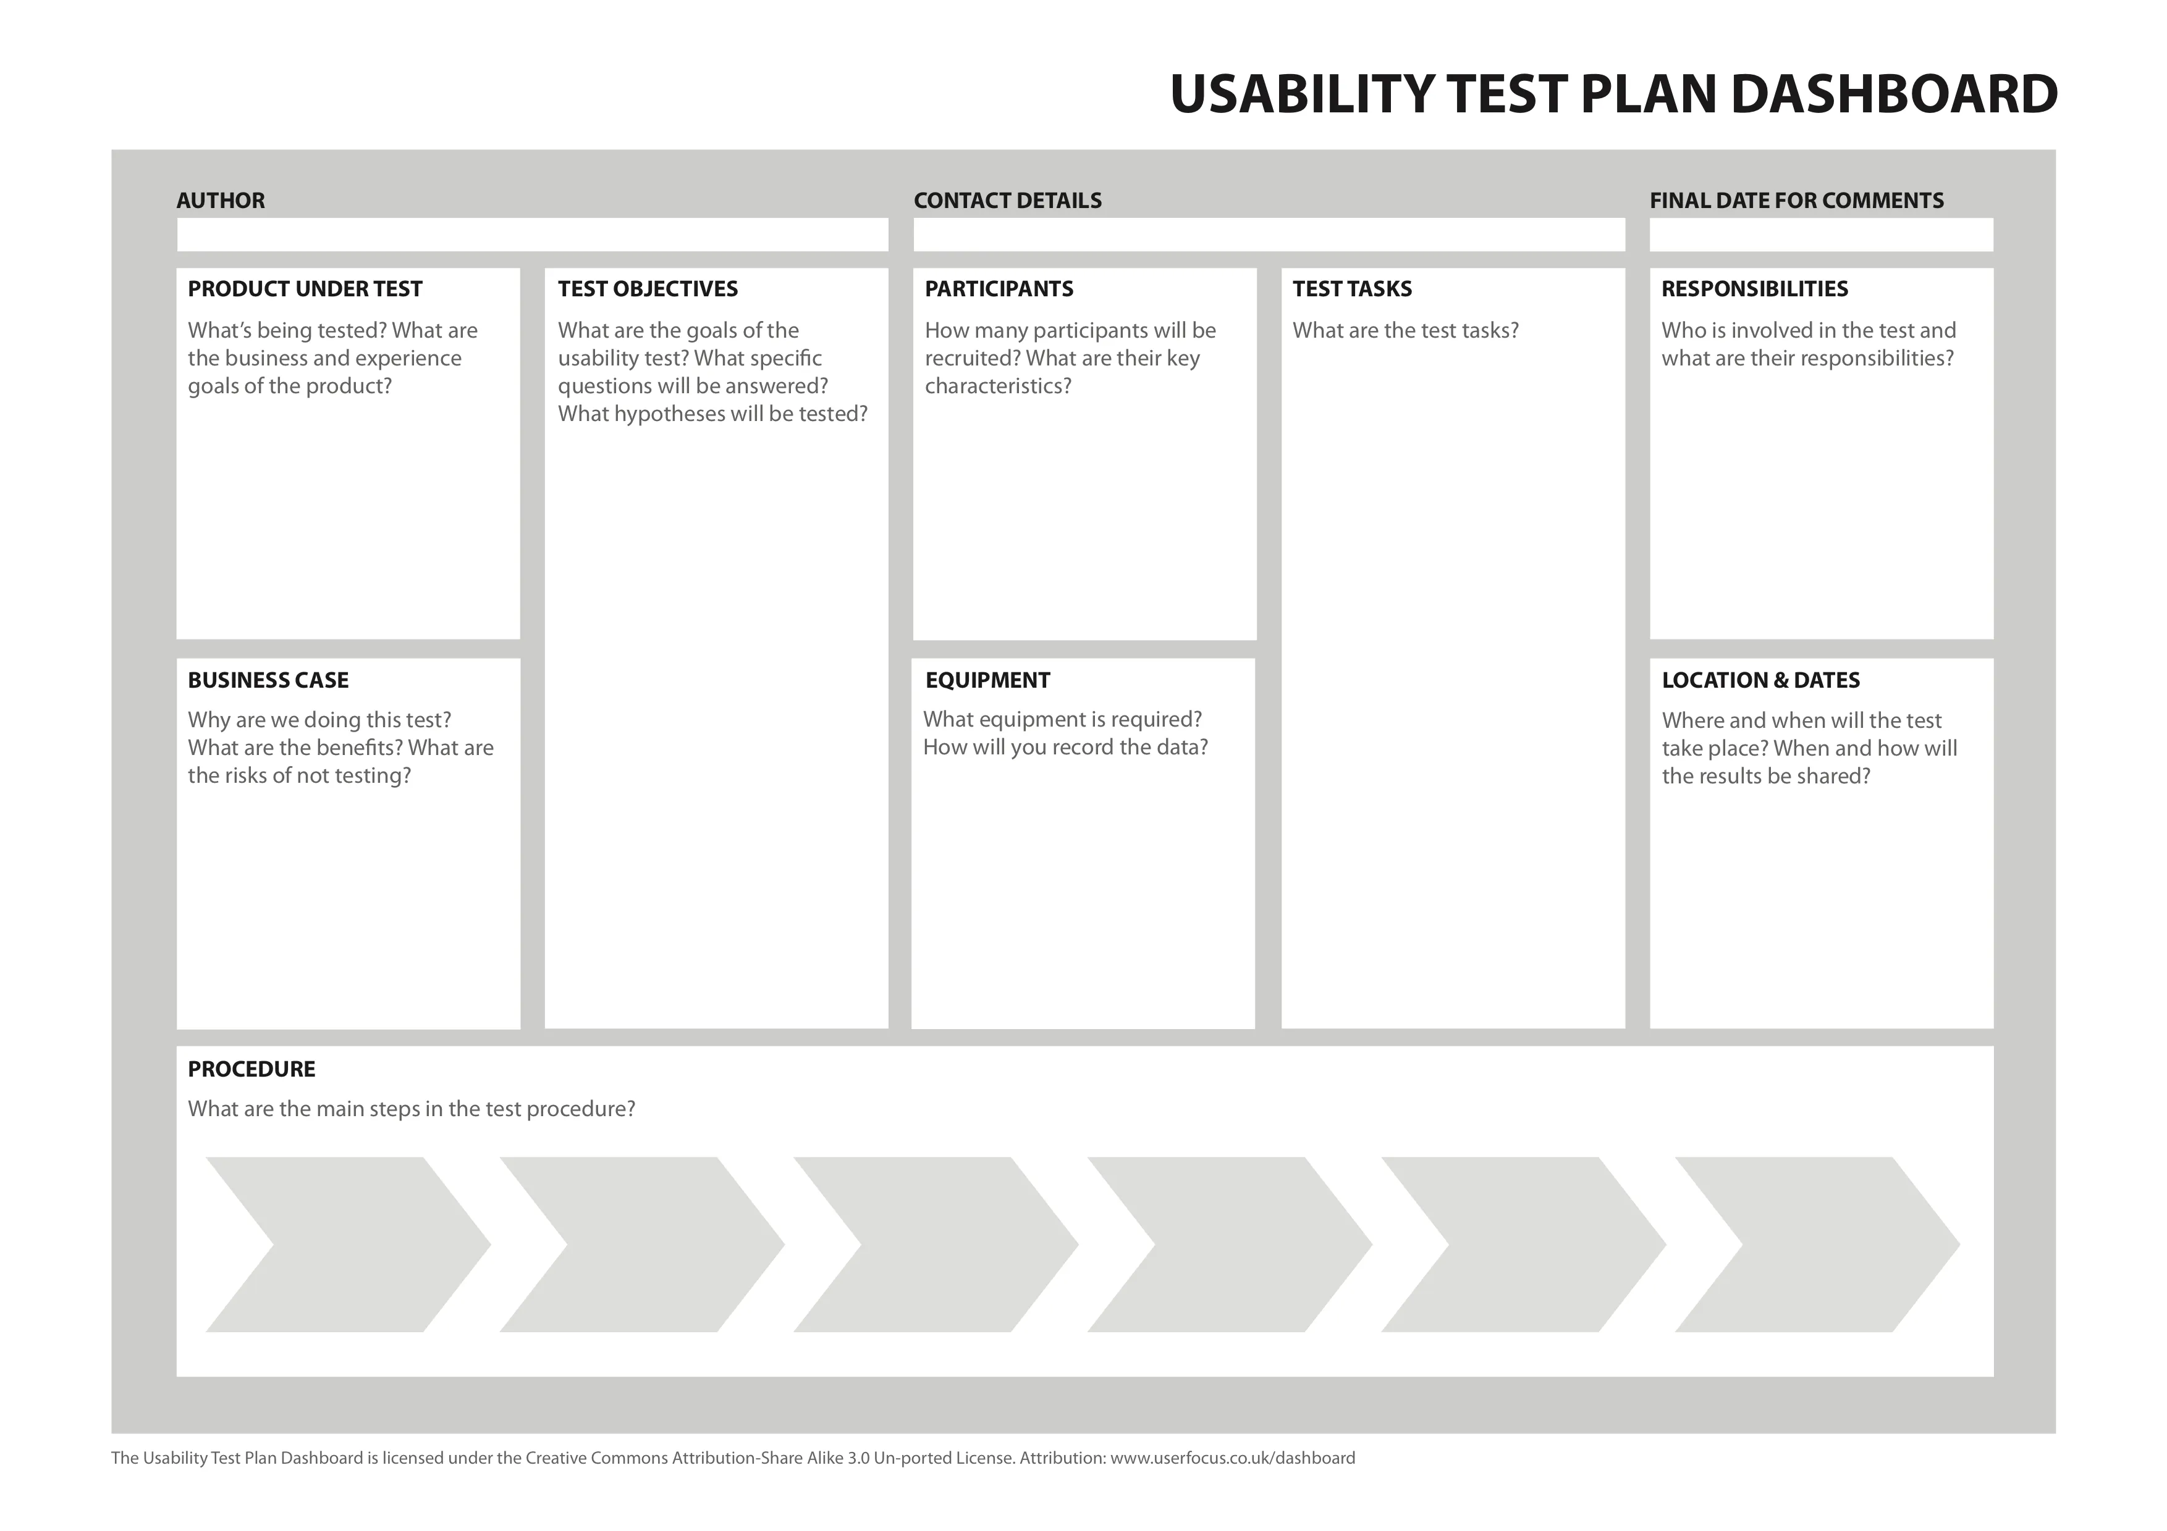
Test plan
Source :https://medium.com/design-bootcamp/a-beginners-guide-for-remote-usability-testing-1d4cacab0ca3
Notes:
This exercise aims to help participants structure a usability test by filling in each section of the canvas:
Prototype to test: Clarify what will be tested (concept, product, service).
Strategy & Objectives: Define the goals of the test and the risks if the test is not conducted.
Hypotheses: List the hypotheses to be validated.
Scenarios & Tasks: Design the user tasks and test scenarios.
Participants: Define the user profile and the number of participants.
Equipment: Identify the materials and tools needed.
Responsibilities: Clarify the roles of each person involved in the test.
Location & Dates: Define where and when the test will take place.
At the end of the exercise, participants should share their test plan with the group for discussion.

Slide 22

Before testing! Heuristics [eu-ri-sti-k']
From German, Latin and Greek "I find" “Discipline which aims to formulate the rules of scientific research” (Larousse) “The art of inventing, of making discoveries” (Littré)
Source: Explore Free Images, Wallpapers, & Backgrounds | Unsplash
Notes:
It is explained here that before conducting user tests, an audit phase will be carried out first because it is less expensive and allows basic problems that would disrupt the user tests to be solved.

Slide 23
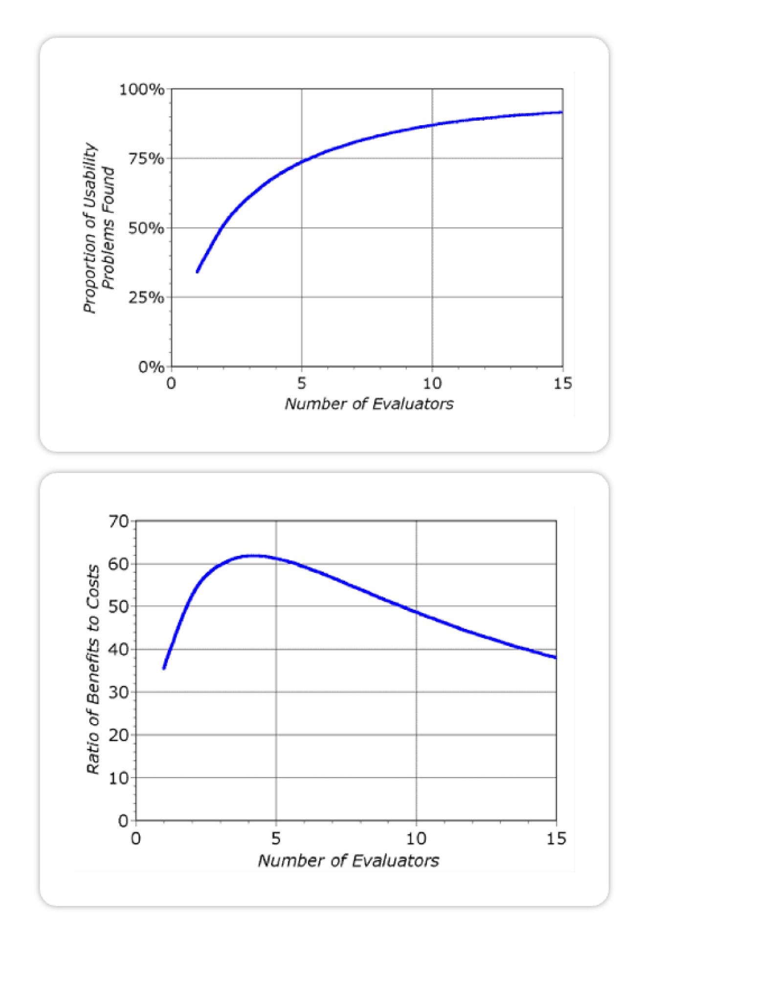
Number of experts
Internally
Give everyone the interface to evaluate with the same grid
In agency
Either same as 1 or ask 1 or 2 other experts to go through the interface and give feedback.
Source: Nielsen Norman Group: UX Training, Consulting, & Research - NN/g
Notes:
With five evaluators auditing the digital project, we can address over 75% of the issues related to usability.

Slide 24
Nielsen's Heuristics
1: Visibility of System Status
2: Match Between the System and the Real World
3: User Control and Freedom
4: Consistency and Standards
5: Error Prevention
6: Recognition Rather than Recall
7: Flexibility and Efficiency of Use
8: Aesthetic and Minimalist Design
9: Help Users Recognize, Diagnose, and Recover from Errors
10: Help and Documentation
Notes:
Here we introduce Nielsen's heuristics. By checking these points, we'll be able to fix quite a few issues. https://www.nngroup.com/articles/ten-usability-heuristics/

Slide 25
Exercise
Exercise time
Start your test plan from the left column
Source :https://medium.com/design-bootcamp/a-beginners-guide-for-remote-usability-testing-1d4cacab0ca3
Notes:
As an exercise, learners are asked to fill in the first two boxes on the far left. Continuation of slide 19 (Do It Yourself context) Duration: 5 to 10 minutes

Slide 26
Classic usability test

Slide 27
Recruiting the right users
Typology: the typical user, the Persona, the key user
5 users = majority of ergonomic problems
Better to have several sets of 5 users than 15 users at once
Recruit, select, explain
Incentive or not?
Reuse the same users?
Notes:
Before launching user tests, we of course need to recruit users. We rely on Personas, which is why we completed the uniC Canvas earlier.

Slide 28
Recording
Caution: In no case should the recording be perceived as intrusive. Have a GDPR charter signed
Recording Types: Audio, video, screen, eye-tracking, EEG, GSR, webcam, …
Isolated element bias: Watching a recording serves as an example, but should not lead to conclusions being drawn too quickly.
You have to see it to believe it: Often your manager or colleague will need to see and hear the user to accept a fact.
Distance or recording: Project leaders can either view the session remotely or afterwards. In any case, the goal is to observe, not to intervene.
Shared experience: Thanks to recording, everyone can hear the same thing, without filters.
Notes:
Recording is an important element for reviewing and analyzing the test in greater depth. Of course, this recording must be approved by the user.

Slide 29
Tips and tricks
Measure: Count the number of clicks, the time required, the number of items retained
Wait: Plan breaks between tasks
Verbalize: Encourage the user to explain what they are doing, why or why not
Listen: Encourage the user to explain what they are doing, why or why not
Specify tasks: Structure your interviews with activities (3 to 4).
To calm: You test the interface, not the user. Tell him.
To call: Start by setting the tone “imagine that…”
Provide the necessary context: Enough to get started, but without guiding the user.
Notes:
What to do during a user test? Measure as many things as possible. Give the user time. Ask them to think out loud. Listen to the user. Be very specific in the tasks. Calm the user. Provide them with context.

Slide 30
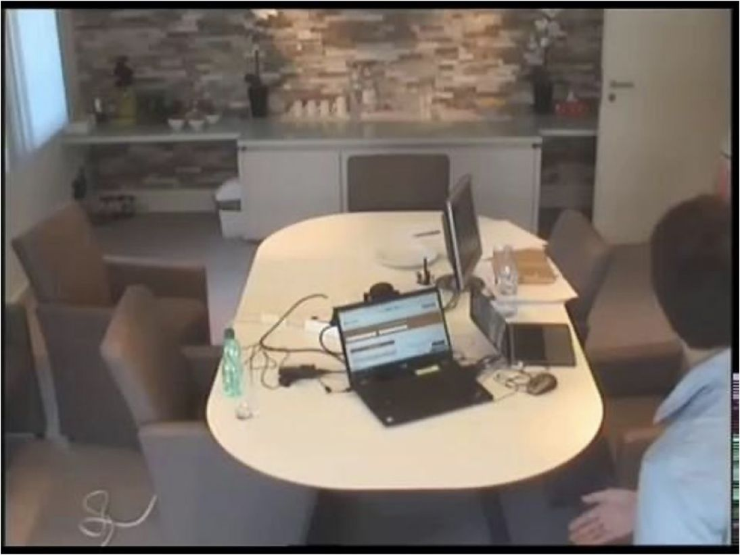
Example – Classic User Tests
Source :JEMS
Notes:
Here, we show the setup for classic tests. You see a laptop in the center that will be used by the participant. On the right, there's a laptop for the examiner along with an extra monitor. The extra monitor allows viewing what the participant is doing without having to lean over their screen. The examiner's laptop is for taking notes. Additionally, in this setup, there's a one-way mirror, meaning an invisible mirror behind which other observers are positioned.

Slide 31
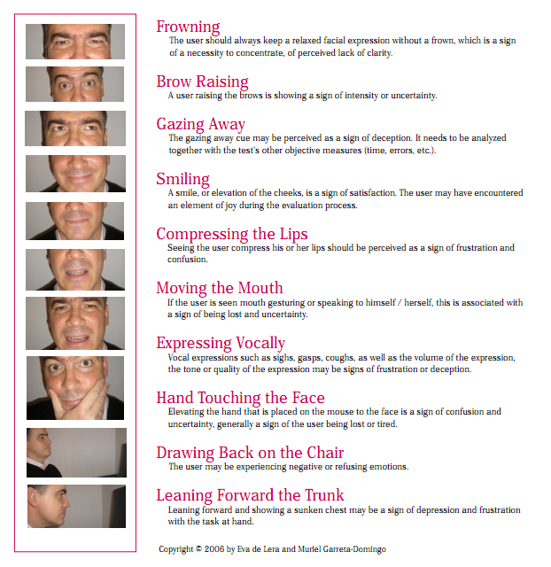
10 Heuristics for Observing Behavioral Reactions
Source: https://www.scienceofpeople.com/
Notes:
A chart for observing facial eyebrows is presented. The most important aspect is the frown, as it either indicates that the person doesn't understand or that they are very interested.

Slide 32
Online test

Slide 33
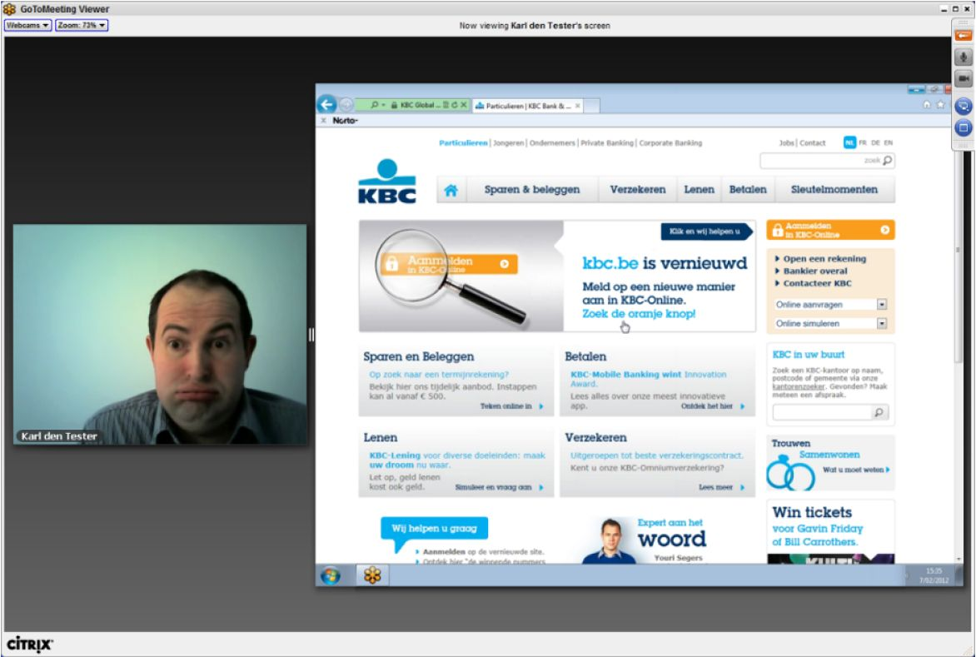
Web Meeting, Teams, Google Meet, Zoom with screen sharing
Source :JEMS
Notes:
This slide illustrates an example of a remote usability test conducted via a web meeting tool (Teams, Zoom, Google Meet, etc.) with screen sharing and webcam.
This setup allows participants to perform tasks on their own device while the facilitator observes both the screen and the participant's facial expressions and body language through the webcam. The webcam is important because it helps:
Capture non-verbal reactions (confusion, frustration, satisfaction).
Create a more natural and human interaction despite the distance.
Identify moments of hesitation or discomfort that might not be visible through screen sharing alone.
Remote testing is useful when participants are geographically dispersed or when in-person testing is not possible.

Slide 34
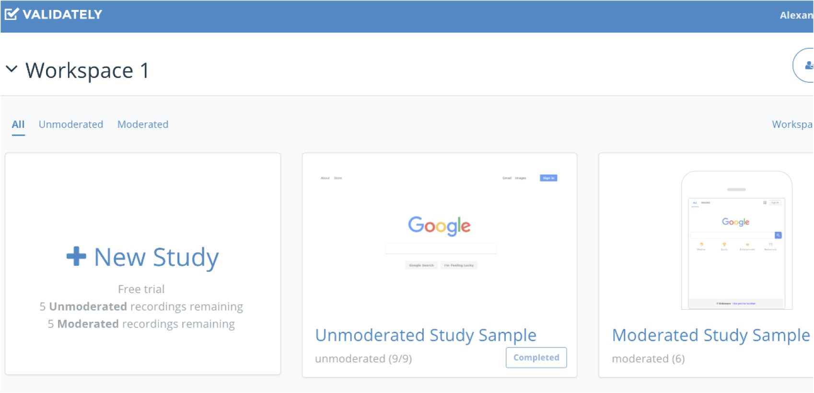
Online user testing: validately, maze, surveymonkey, loop11
Source :JEMS
Notes:
It is possible to conduct unmoderated online tests, meaning the user will perform tasks without an evaluator present. The advantage is that the user can take the test whenever they want.

Slide 35
Guerrilla Testing

Slide 36
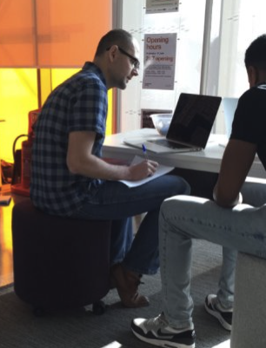
In guerrilla mode
No prerequisites “Everyone” can do it!
15 minutes for the test
1 day of preparation
0.5 passing / 0.5 restitution
Less complete than a classic test
Coping with the vagaries of “real” life
Easier on B2C than B2B
Source :JEMS
Notes:
Guerrilla testing involves creating a brief test protocol and heading straight out to recruit users in the field. The main advantages are speed and low cost, but the downside is reduced precision.

Slide 37
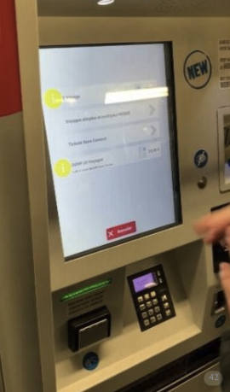
In guerrilla mode
Guerilla User Testing in Brussels Sub
Source :JEMS
Notes:
Here's a sample photo from a guerrilla test conducted in the Brussels metro. We (Anaïs Digital – Jems) had an observer and an interviewer. The test lasted about 15 minutes.

Slide 38
Neurosciences

Slide 39
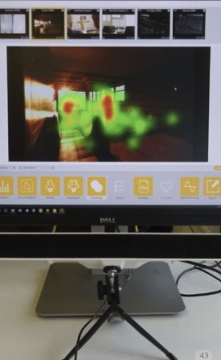
Biometrics – User Testing
Eye Tracking
Facial analysis
Heart rate and skin conductance
Source :JEMS
Notes:
The use of neuroscience in user testing adds a scientific perspective to the tests. Various tracking techniques are employed, such as eye tracking, facial analysis, skin conductance, and heart rate. All this biometric information tells us about emotional intensity, gaze at the screen, and more.

Slide 40
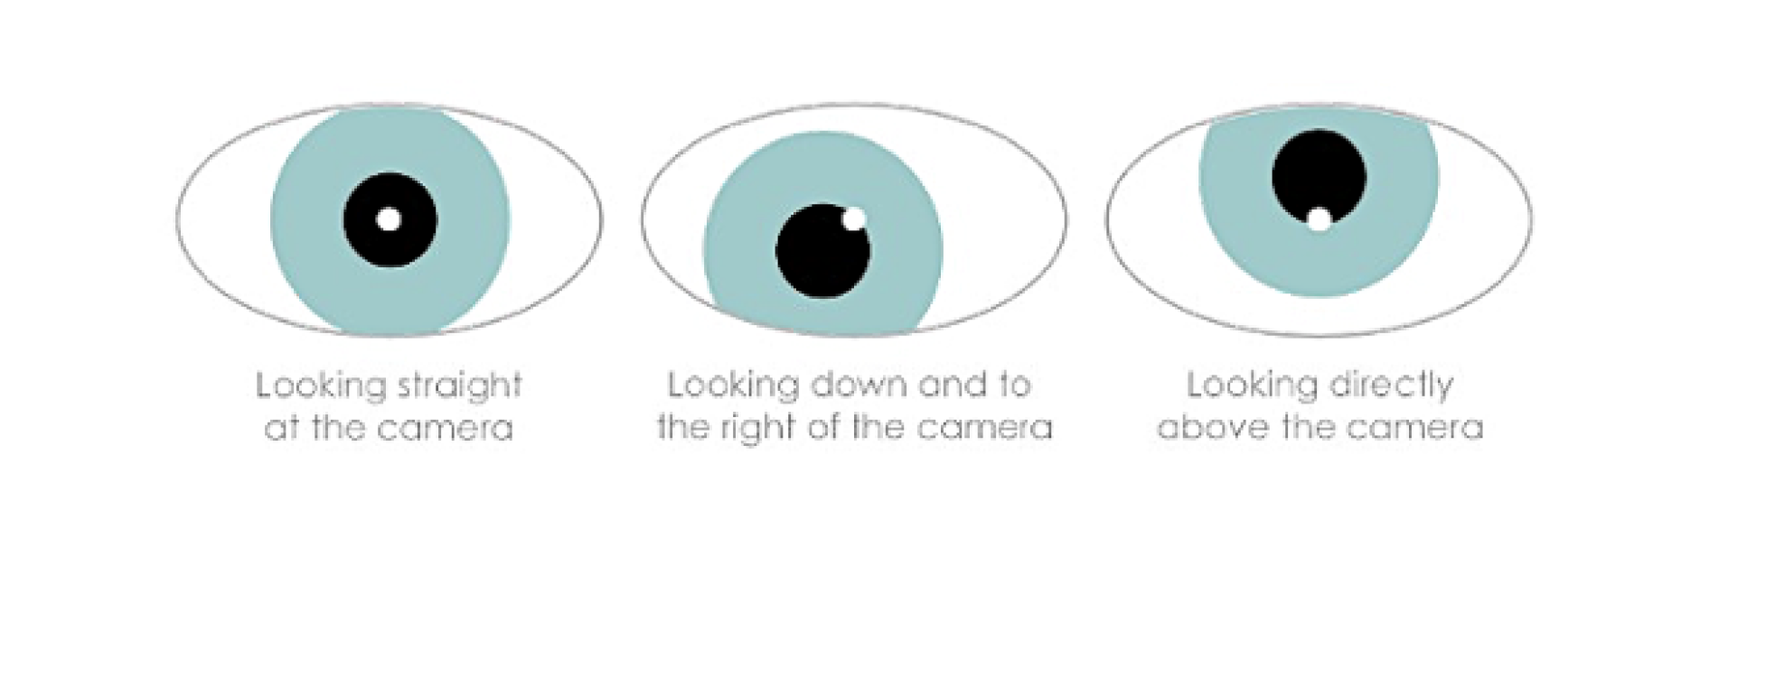
Biometrics – User Testing
Fixations and jerks These are the two observations made by the eye-tracker: what does the user focus on and how do his eyes move? Order, object, time, quantity Are the values recorded by the eye-tracker to determine heat maps and paths. Eye-tracker This is the non-intrusive tool used to observe eye movement on the screen.
Source: https://medium.com/usabilitygeek/eye-tracking-what-is-it-for-and-when-to-use-it-e54d497e5a48
Notes:
Eye tracking is commonly used in user testing. It allows us to objectively analyze where the user focuses on the screen and identify the areas that are most viewed versus those that are overlooked. It also enables tracking the path of the eye across the screen.

Slide 41
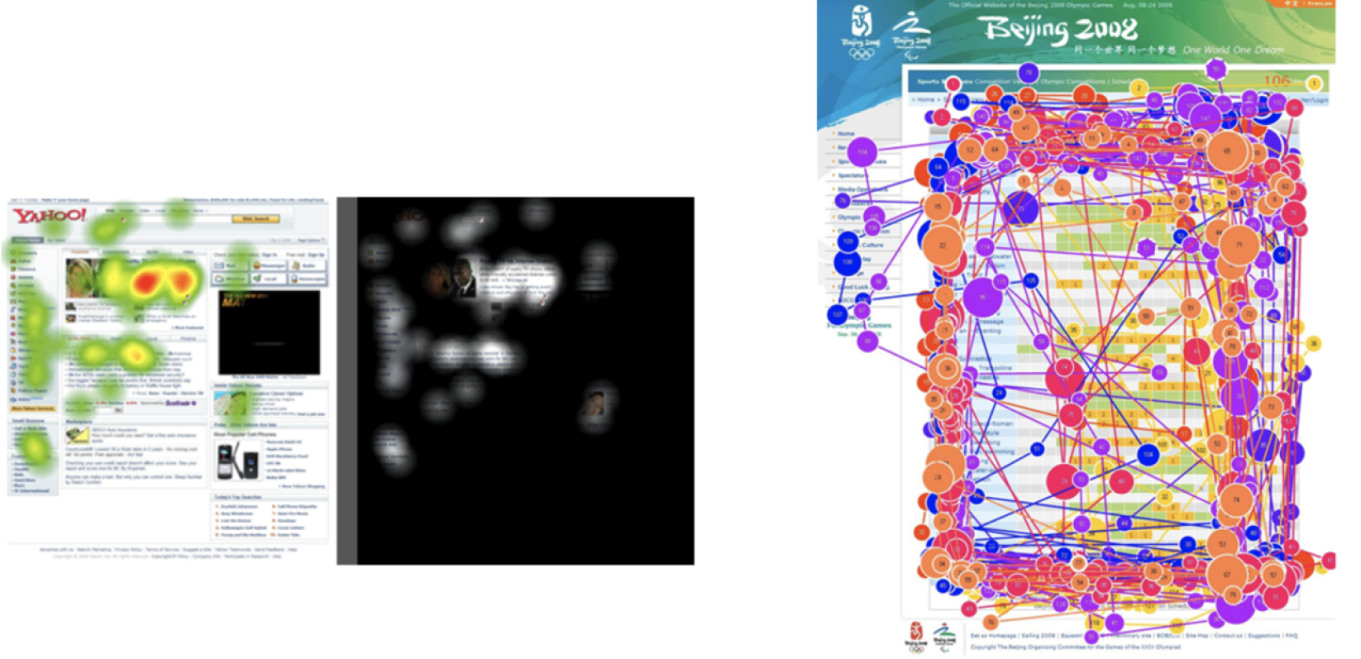
Eye-tracking: Examples
Source: Nielsen Norman Group: UX Training, Consulting, & Research - NN/g
Notes:
Here are examples of eye tracking, visible areas, and eye movement paths across the screen.

Slide 42

Eye-tracking: Examples
Observing the unobservable During a user test, users explain what they are doing, but are not always fully aware of it. Quantify With heat maps, we can give weight to the fixations, to the most traveled paths,. Convince This objective measure is a strong argument for strategic decisions on screens. It is also a visual way of presenting information.
Source :JEMS
Notes:
Eye-tracking helps analyze:
Why participants struggled to complete a task.
Where participants expected to find certain elements.
Whether participants noticed a particular element—such as a link, button, advertisement, or newly added UI feature.
Whether certain elements are distracting in a negative way.
How effectively a design guides participants in completing their tasks.
If there are differences in task performance between user groups (e.g., new vs. experienced users).
What content participants read (articles, instructions, contextual help, error messages).
How participants process information—by reading details or scanning.
Whether a specific design is more effective than another in terms of user experience or business objectives.

Slide 43
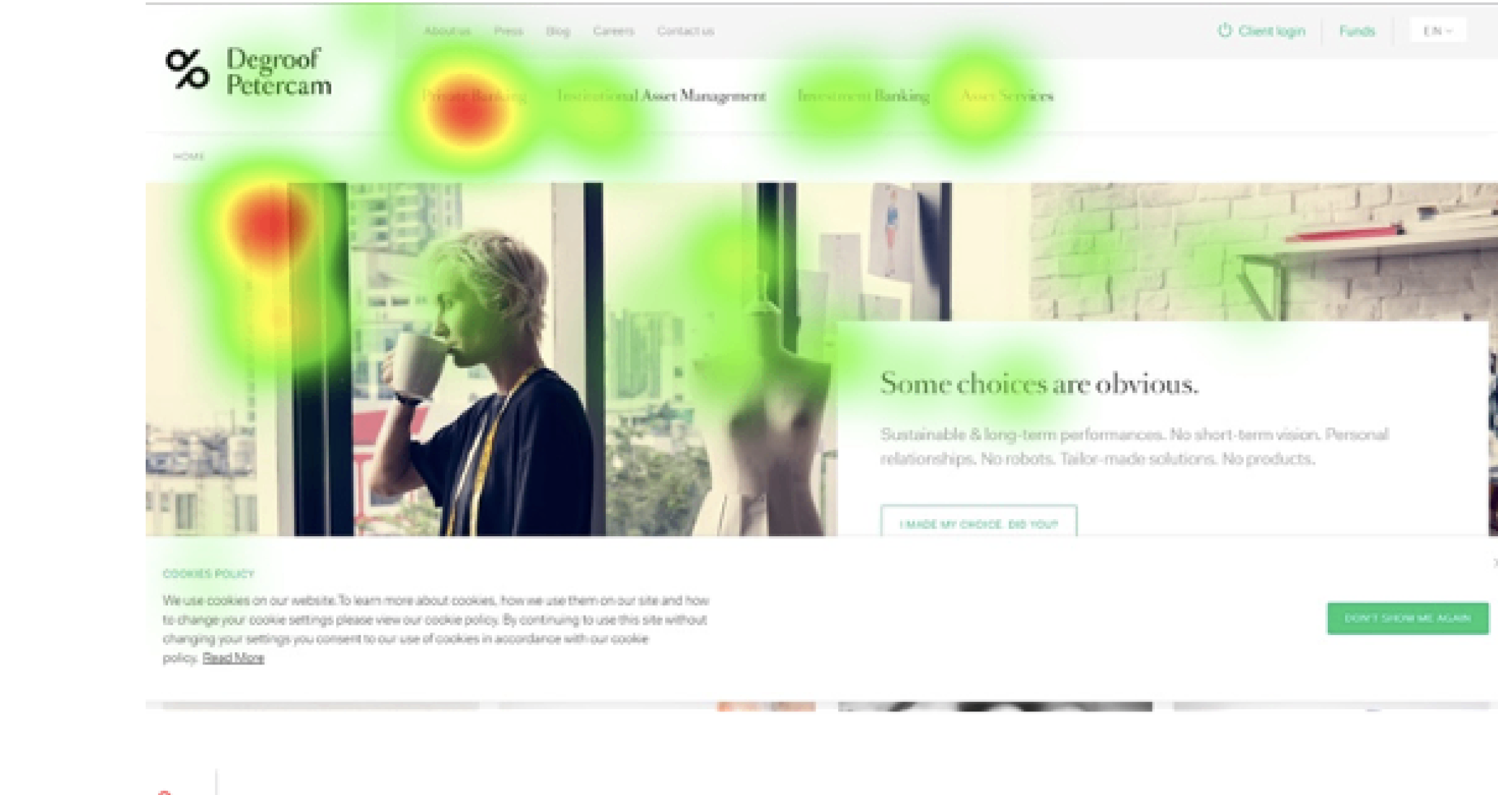
The Faces: Eye-tracking
The role of mirror neurons
Empathy
Online trust
Jems
Notes:
Light tracking can highlight the areas viewed by the user. In this example, we see the importance of mirror neurons. The user's gaze mimics the gaze of the person in the illustration. The illustration should be flipped to guide the user's gaze towards the text and the main message.

Slide 44
Exercise
Exercise time
Fill in the center and right columns
Source :https://medium.com/design-bootcamp/a-beginners-guide-for-remote-usability-testing-1d4cacab0ca3
Notes:
I ask the learners here to complete the middle column with the participants and equipment, as well as the far-right column with the responsibilities, locations, and dates. Continuation of slide 19 and 25 (Do It Yourself context) Duration: 5 to 10 minutes

Slide 45
2. Create your test protocol and follow it

Slide 46



Drafting the protocol
Test plan
2. Test Protocol
3. Dry run
Notes:
In this section, we will finish completing the test plan, then draft the test protocol. We should end with a dry run, which means testing the protocol.

Slide 47
The four main stages of a test
1. Introduction
2. Scenarios
Provide context to the participant Explain how the interview will take place Collect demographic data
Tasks to be completed
3. Questionnaire
4. Debriefing
Administration of one or more standardized questionnaires
Questions to end the interview on the lived experience
Notes:
Here, we present the four main stages of a user test. It begins with an introduction, followed by the user executing test scenarios. Then, a standardized questionnaire is used, and finally, we debrief with the user about how the test went.

Slide 48
Introduction
Reassure the participant about the progress
Explain that there is no right or wrong answer
It is the system that is tested, not the user
Notes:
The purpose of the introduction in a user test is to reassure the participant, explain how the process will unfold, and remind them that it’s the system being tested, not the user.

Slide 49
Introduction
Welcome - Provide a warm welcome (drink), explain the incentive (if present) after the discussion.
Researchers - Ideally an observer who takes notes and a person who asks questions.
Place - Choose a comfortable location, avoiding distractions
Note taking - Print the discussion guide and prepare a note-taking structure.
Notes:
We're setting everything up so the test goes as naturally as possible.

Slide 50
Introduction
Example
Good morning,
We are currently conducting a study in the field of [domain]. We have created a solution in the form of a prototype that we would like to test. This is the prototype that I will present to you today.
First, I'm going to ask you some general questions. Then you will have the opportunity to interact with the application. I will ask you to complete a few tasks. After each task, we will have the opportunity to debrief.
This is really the prototype we are testing today, not you. So don't hesitate to be critical. Your feedback is really important to us.
If you agree, we will record the session. This allows us to review the tests and analyze the results (have the registration agreement sheet signed).
Notes:
Here's an example of an introduction one might use for a user test.

Slide 51
Scenarios
A scenario is the heart of the test protocol. This is a detailed description of the tasks that users need to accomplish. Scenarios should be written according to the test plan, the objective being to ensure that the results meet the assumptions set beforehand.
A main objective
The context
Determine the goal the user needs to achieve. The objective should be directly related to the hypotheses you want to test (in the test plan). (eg perform action X, find information Y).
Provides the context necessary for the user to understand the situation they are in, including available information and starting point. The context helps to make the scenario more realistic and to better understand the user's needs.
Notes:
Next, we move on to the task scenario that the user will need to complete.

Slide 52
Scenarios
Logical order of scenarios
The criteria for a good script
Follow the order of the scenarios should reflect the journey of a real user. For example, if we want to check that a user can request a document and download it, we will do it in this order (and not separately). This helps to detect potential obstacles throughout the process.
Clear and concise: Easy for everyone to understand. Realistic: Reflects the behaviors and expectations of real users. Flexible: Takes into account different possible paths. Measurable: Allows you to collect qualitative data.
Notes:
Next, we move on to the task scenario that the user will need to complete.

Slide 53
Scenarios
Use the user's language
Ask open-ended questions
Use the same vocabulary as your participants so that they can easily understand your questions. Avoid using technical terms or jargon if you don’t need to.
Encourage detailed responses rather than simple “yes” or “no.” Do not hesitate to contact the user again when he seems to be having difficulties, or when he does not provide enough information.
Be specific in your instructions
Non-leading questions
Specific tasks help to obtain clear and actionable information. Be careful not to give the expected solution or action.
Let your participants express themselves freely without influencing them. Avoiding leading questions ensures the objectivity of the answers.
Notes:
Here are some tips and tricks for writing relevant scripts.

Slide 54
Scenarios
It is essential to first observe the user completing the given scenario alone, taking notes on his behavior and difficulties.
Ask questions to clarify his actions and gather his impressions:
After each scenario: Ask specific questions related to what you just observed.
Review any obstacles or positive points the user encountered during the scenario. These questions are part of the protocol and are defined in advance. Example of clarification questions:
“Could you explain to me why you chose to click on this button?” “What did you think of this stage?”
Notes:
Of course, we make sure that beyond just carrying out the scenario, we take note of the entire test environment, non-verbal observations, and so on.

Slide 55
Scenarios examples
Task 1:
You have just moved into a new apartment as a tenant. You want to replace some
old furniture and give your home a new look. But you don't have enough savings for
your project... You are missing €4,700.
On the bank's website, you look for a loan suitable for this type of expenditure.
Task 2:
You are considering investing savings in an investment fund. To receive
personalized advice, you want to meet an advisor in an agency.
Find the bank branch closest to your home or workplace.
Notes:
Here are two example scenarios.

Slide 56
Scenarios
5 sec test
Show a user screen for 5 seconds.
Then, he's asked what he's noticed in terms of words, messages, colors, images, and structures.
This allows for defining the first impression.
Conduct a five-second test in pairs in the class, using the interface of your choice.
Notes:
We can also use specific scenarios like the five-second test. to be done in class. Choose a user screen you want, show it for 5 seconds to your classmate.

Slide 57
Questionnaire
Using a standardized questionnaire to assess user experience
Notes:
Ask the students what information it will contain

Slide 58
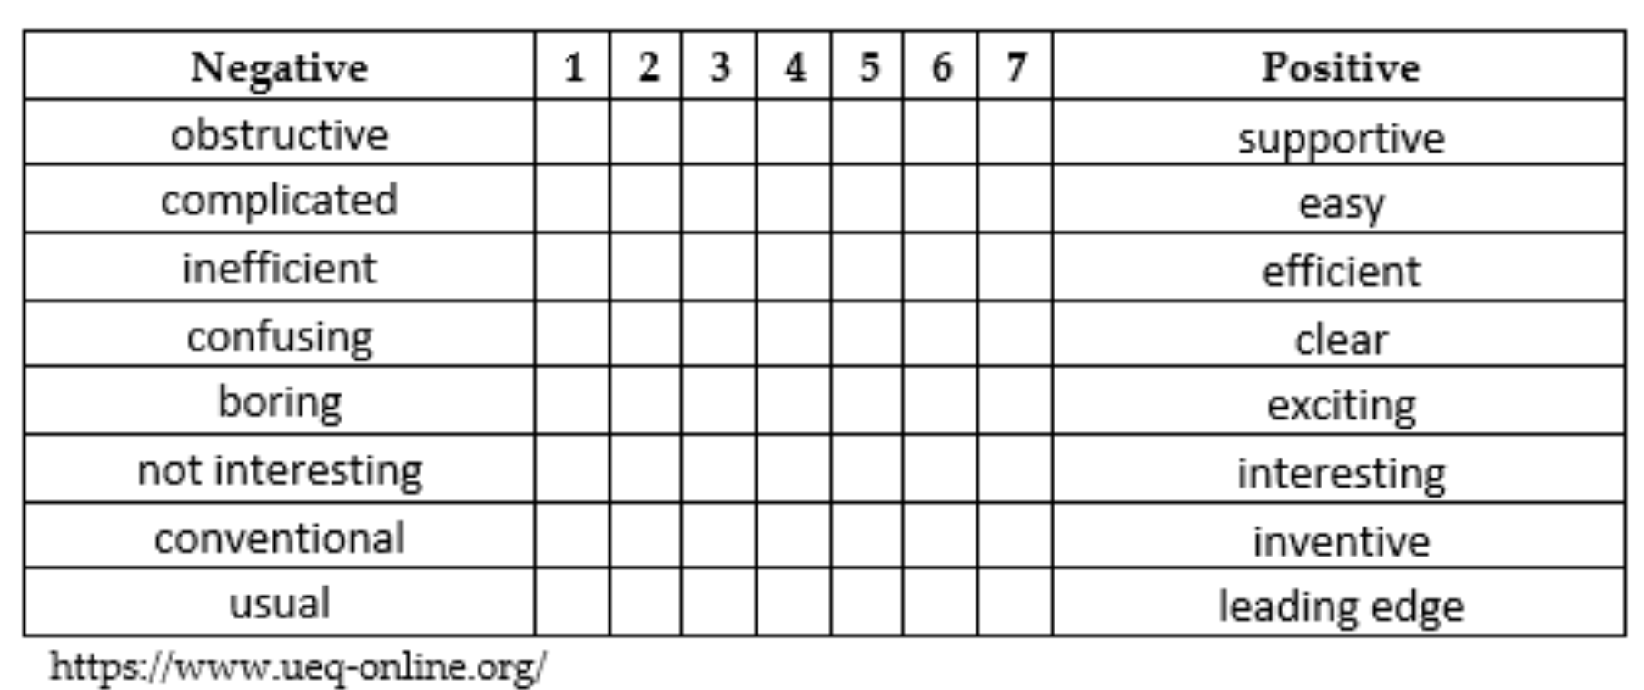
User Experience Questionnaire
Notes:
Here is the User Experience Questionnaire. This standardized questionnaire is available in several languages. It allows for the objectification and quantification of the user experience.

Slide 59
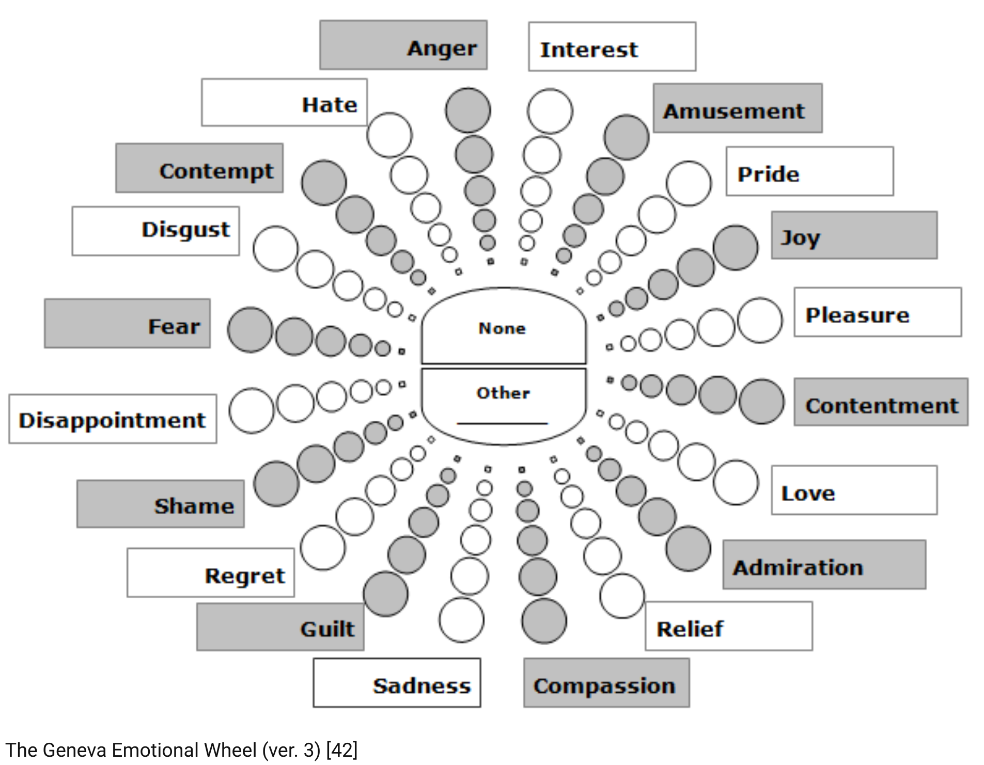
Geneva Emotion Wheel
Notes:
Here we present Geneva's wheel of emotions. It's a standardized tool that allows participants in a user test to assess their emotions.

Slide 60
Debriefing
This part is essential to close the test in a positive way and gather additional information.
Conclusion and General Feedback
Using the closing questions, ask the participant to give overall feedback on the test, going back over the positive and negative points.
Participant Questions
Thanks and incentive
Allow time for the participant to ask all their questions. Be honest and transparent in your answers. “Do you have any questions for us?”
Thank the participant and offer them compensation (goodies, voucher).
Notes:
The debriefing after user scenarios is a crucial moment to gather final insights, see if the test went smoothly, and of course, to thank the participants and explain how they will be compensated.

Slide 61
Debriefing
How much did you enjoy this App? (on a scale of 1 to 5)
What did you like most about your experience with this App? For what?
What did you like least about your experience with this App? For what?
Were there any things that surprised you? Are there things you expected that you didn't find?
How could we improve your experience on this App?
What do you think about this way of approaching this problem?
How much would you recommend this platform? For what? (from not at all to completely)
Do you think this product will help you? For what?
Do you think you can trust this product? For what?
Other comments
Notes:
Here is a series of questions that can be asked during debriefing, at the end of the user test.

Slide 62
Dry Run
A dress rehearsal before the big day allows us to refine the protocol and ensure that everything will go as planned.
Teamwork
Proofreading
Try your test protocol on a colleague who is not involved in the project.
Check whether the scenarios, tasks and questions are clear and understandable.
Estimate the time needed
Hardware check
Make sure the time allowed is sufficient. Otherwise, make choices based on the topics you have prioritized.
Make sure that the necessary equipment is working properly: computer, printer, as well as the route to be tested.
Notes:
Before conducting user tests with actual users, it's recommended to do a dry run, which means running a trial test with a colleague, for instance.

Slide 63
Exercise
Exercise time
Write scenarios, tasks and procedures. Your plan should be complete now
Additional resources : https://digital.gov/resources/digitalgov-user-experience-resources/digitalgov-user-experience-program-usability-starter-kit/
Medium
Notes:
Ask the students to draft the scenarios, tasks, and finally the procedure so that the test plan is thoroughly complete. (I ask the learners here to complete the middle column with the participants and equipment, as well as the far-right column with the responsibilities, locations, and dates. Continuation of slide 19, 25 and 44 (Do It Yourself context)
Objective: Learn how to write relevant and realistic user test scenarios and tasks.
Instructions:
Based on your hypothesis and target user, write 1 or 2 test scenarios.
For each scenario, define 2 to 3 clear and measurable tasks the user must complete.
Make sure the tasks reflect realistic user goals.
Notes for the trainer :
Encourage participants to be concrete and precise when writing scenarios. The tasks should allow them to observe behaviors and identify usability issues.
Duration: 10 to 15 minutes

Slide 64
3. Analyze
Notes:
We're already talking about the analysis here, before the test has been conducted, so that the learners can anticipate and see what information they'll need to gather.

Slide 65
Taking effective notes
Segment
Use codes
New hypotheses
Using themes (needs interviews)
Quote to remember, problems, solutions, expectations, tasks, behaviors, …
Identify new questions or hypotheses for the next participant to test.
Notes:
It's indeed crucial to take accurate notes during the user test. We try to segment things, add tags, and also see if any new hypotheses emerge.

Slide 66
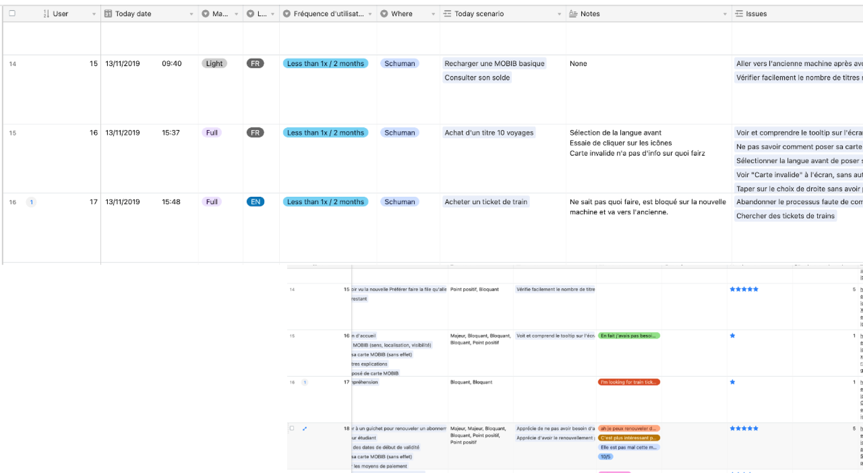
Using a tool like Airtable...
Source : JEMS
Notes:
To take effective notes, tools like Airtable can be used.

Slide 67
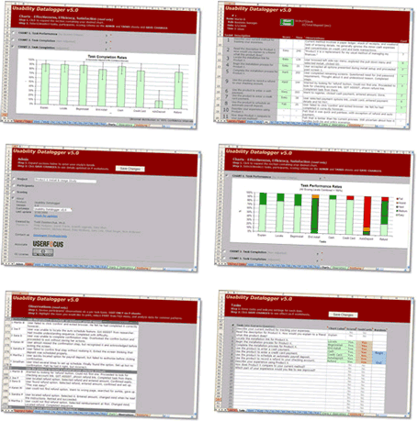
or just Excel.
https://www.userfocus.co.uk/resources/datalogger.html
https://digital.gov/resources/digitalgov-user-experience-resources/digitalgov-user-experience-program-usability-starter-kit/
Source: https://www.userfocus.co.uk
Notes:
We can also use User Focus tools with Excel, which are extremely powerful. They are also free. https://www.userfocus.co.uk/resources/datalogger.html

Slide 68

Exercise
Exercise time
Conduct a test and use excel datalogger
Additional resources : https://digital.gov/resources/digitalgov-user-experience-resources/digitalgov-user-experience-program-usability-starter-kit/
Notes:
Objective: Practice conducting a short user test and analyzing the results. Instructions:
Pair up with another participant. One will play the role of the user, the other the observer.
Choose one of your scenarios and conduct a short test (5-10 minutes).
Take notes about difficulties, behaviors, positive/negative reactions.
Switch roles and repeat.
Analyze together the key findings and pain points observed.
Notes for the trainer : This is a simplified, informal exercise. The goal is to experience the dynamics of a user test and practice observation and note-taking.

Slide 69
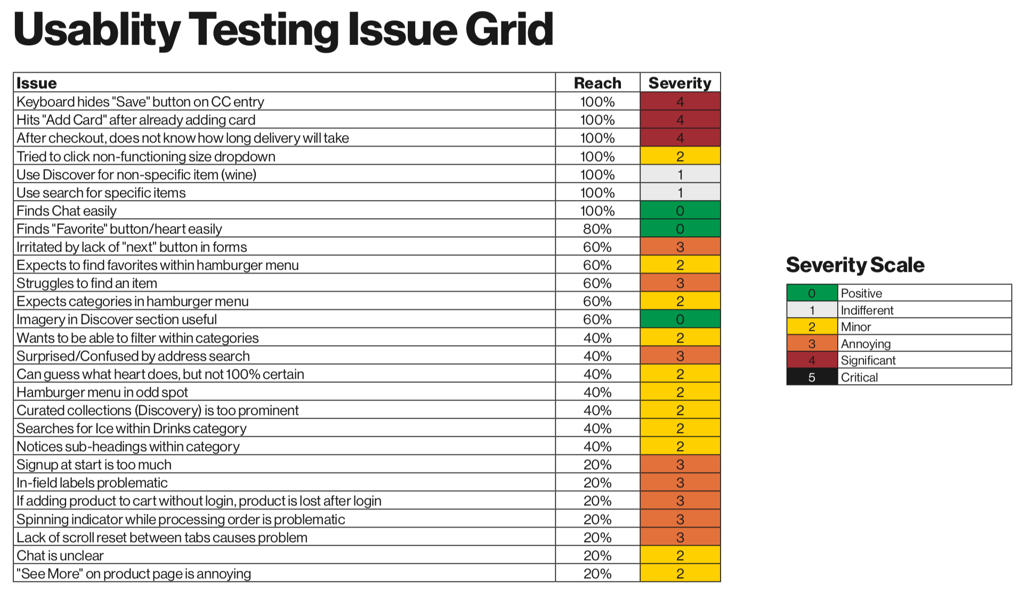
Analyze
Look for global trends
Analyze the questionnaires
Observe the frequency, recurrence and impact of problems on each screen and in the flow (time, errors, clicks, etc.)
Identify wording problems: misunderstanding, reformulation
Identify the positive aspects to keep
Formulate recommendations
Define the next steps of the project (iteration, new, tests, etc.)
Source: Mark Montri
Notes:
How to simply analyze ?
Look for global trends
Analyze the questionnaires
Observe the frequency, recurrence and impact of problems on each screen and in the flow (time, errors, clicks, etc.)
Identify wording problems: misunderstanding, reformulation
Identify the positive aspects to keep
Formulate recommendations
Define the next steps of the project (iteration, new, tests, etc.) https://digital.gov/resources/digitalgov-user-experience-resources/digitalgov-user-experience-program-usability-starter-kit/

Slide 70
Exercise
Exercise time
Perform the analysis
Additional resources : https://digital.gov/resources/digitalgov-user-experience-resources/digitalgov-user-experience-program-usability-starter-kit/
Notes:
Analyze together the key findings and pain points observed.

Slide 71
4. Make a report

Slide 72
Consider the audience for your results
M
A
Memorable
Actionable
Use stories, comparisons, anecdotes and visuals to reinforce results.
The results should be used to make decisions (either find a solution or improve a screen, etc.)
T
A
Transferable
Accessible
Subdivide the results (by theme, by screen, etc.)
The search results must be able to be read and reread by the people concerned.
Notes:
Think about who is going to receive your usability test report: developers, marketers, C-levels ?
Who will receive the results? A designer? A developer? An entrepreneur? A senior manager of a bank?
What is the level of affinity with the subject studied?
What is their level of involvement in the project?
What level of detail do they need?

Slide 73
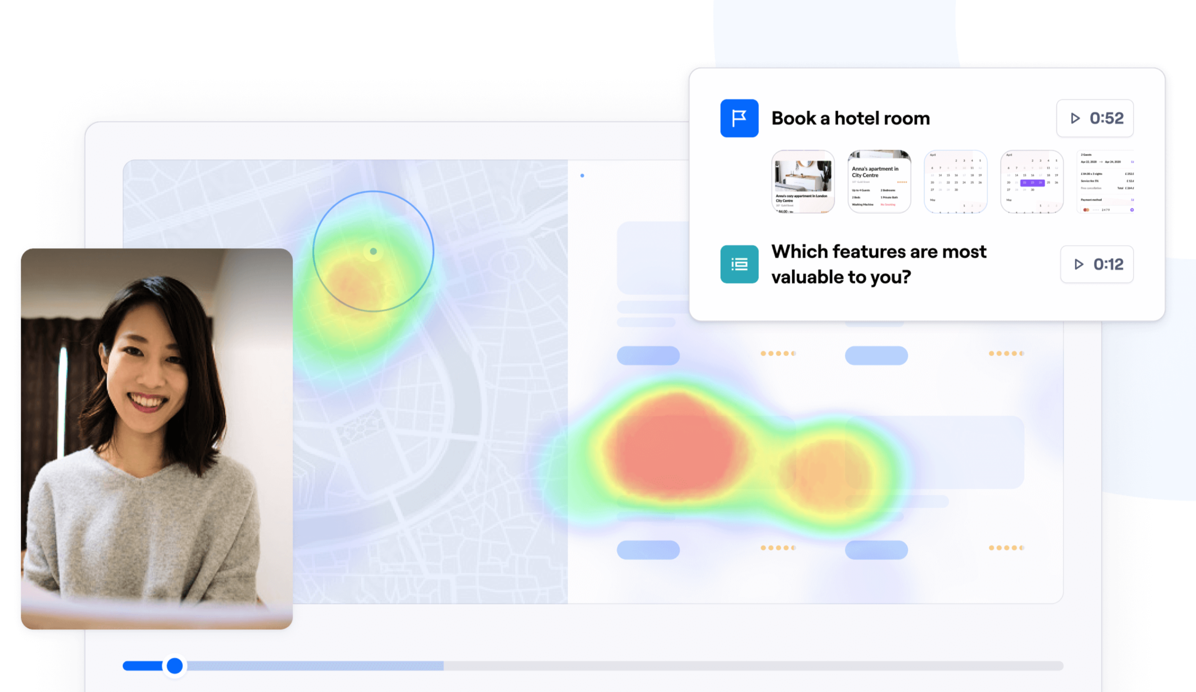
Example of a “ready-made” report
Using Tools like Make Design to automate the maximum of usability testing tasks.
https://app.maze.co/report/Accommodation-platform-User-Research-Report/ef2h9tlsyqag18/intro/demo
Source: https://auth.maze.co/signup
Notes:
This an example created on Maze Platform.

Slide 74
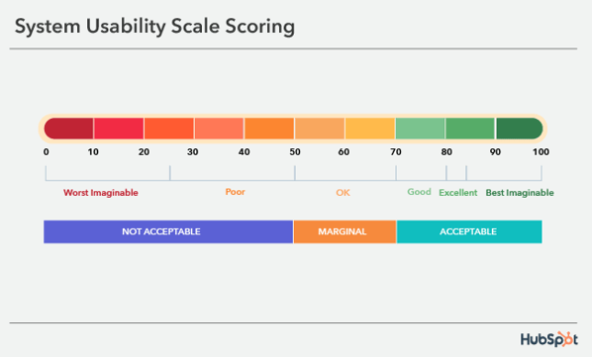
Standardized questionnaire
Source: https://blog.hubspot.com/service/system-usability-scale-sus
Notes:
Add the results of your standardized questionnaire (UEQ, SUS, UMUX, …) in your report.

Slide 75
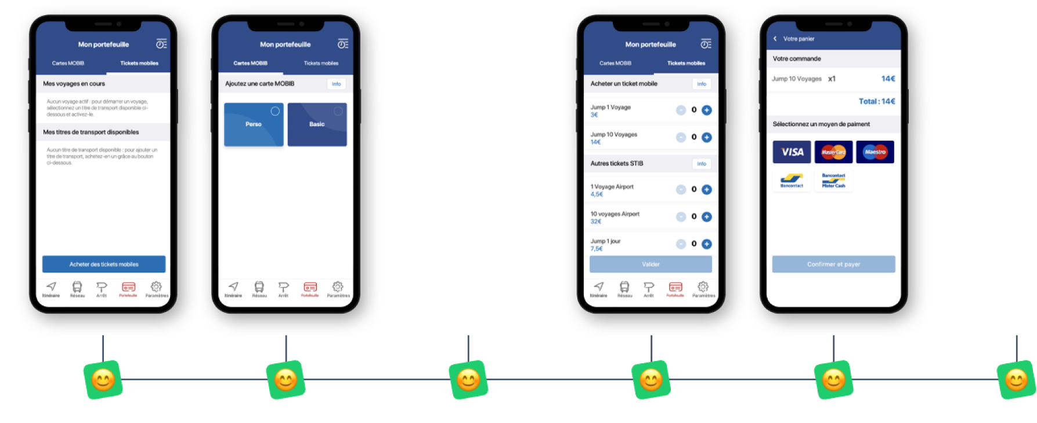
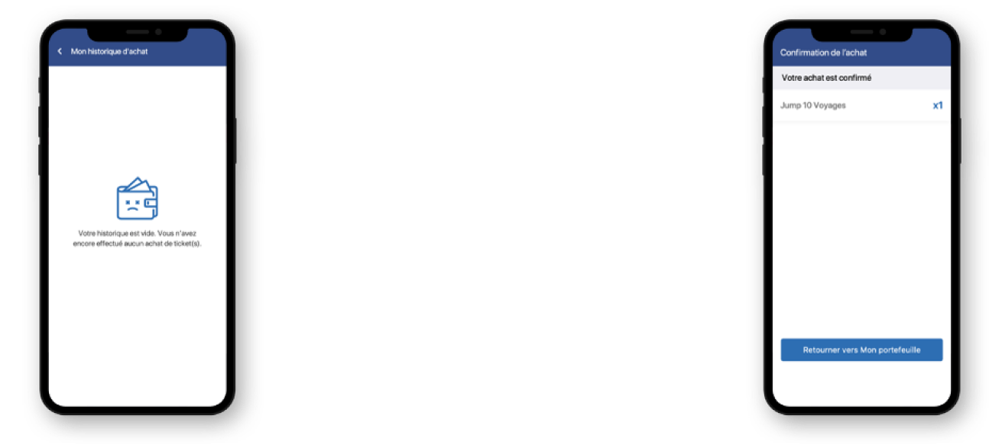
User Flows
Source : JEMS
Notes:
Showing visually success and fails, like this user fails, helps to directly identify pain points

Slide 76
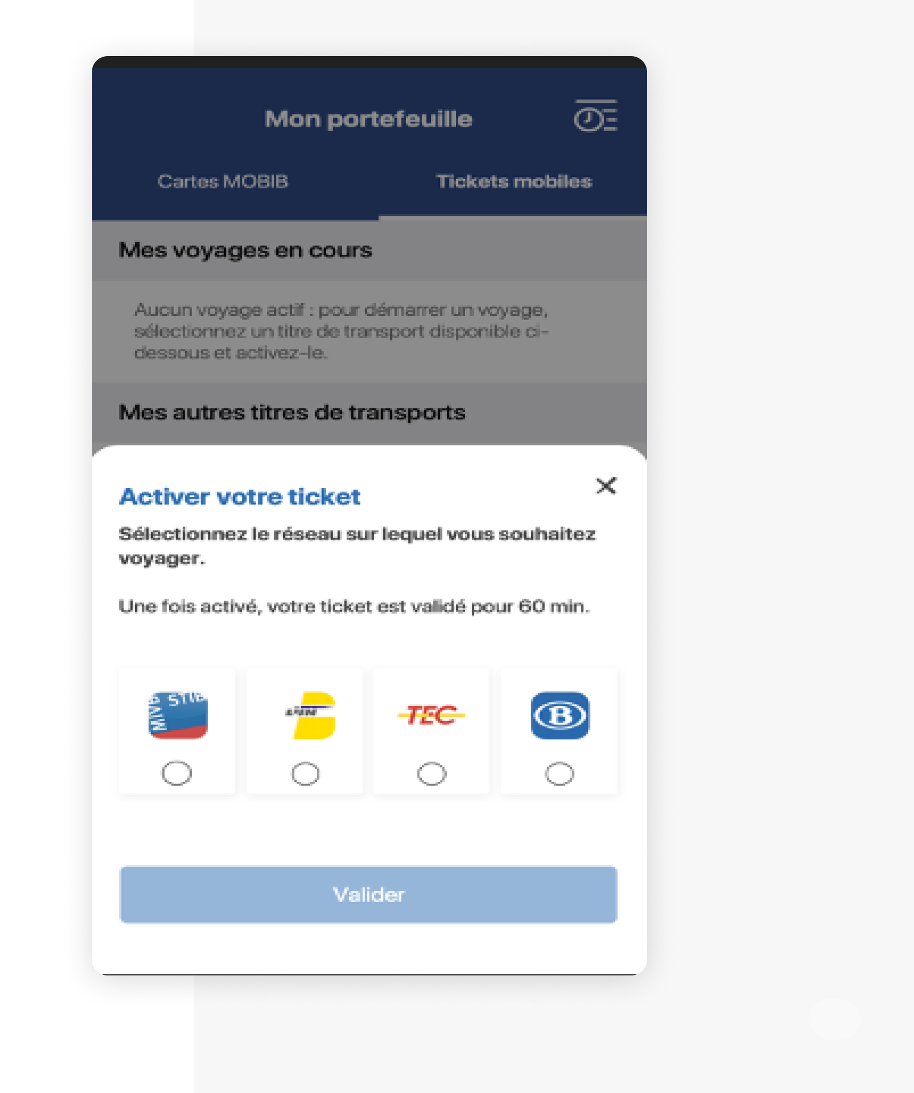
Example : Recommendation on “Activate your ticket”
Observation
The text is scanned diagonally This action is seen as immutable for the current ticket Many users do not associate “activation” and “validation” When they later recall this action, it is associated with the purchase of the ticket rather than its validation.
Recommendation
Refocus on the fact that this action validates the ticket rather than the intermodal aspect - the combination of the two is not understood
Source : JEMS
Notes:
This a standard detailled slide about usability issues. It includes what we observed during the test and what we recommend.

Slide 77
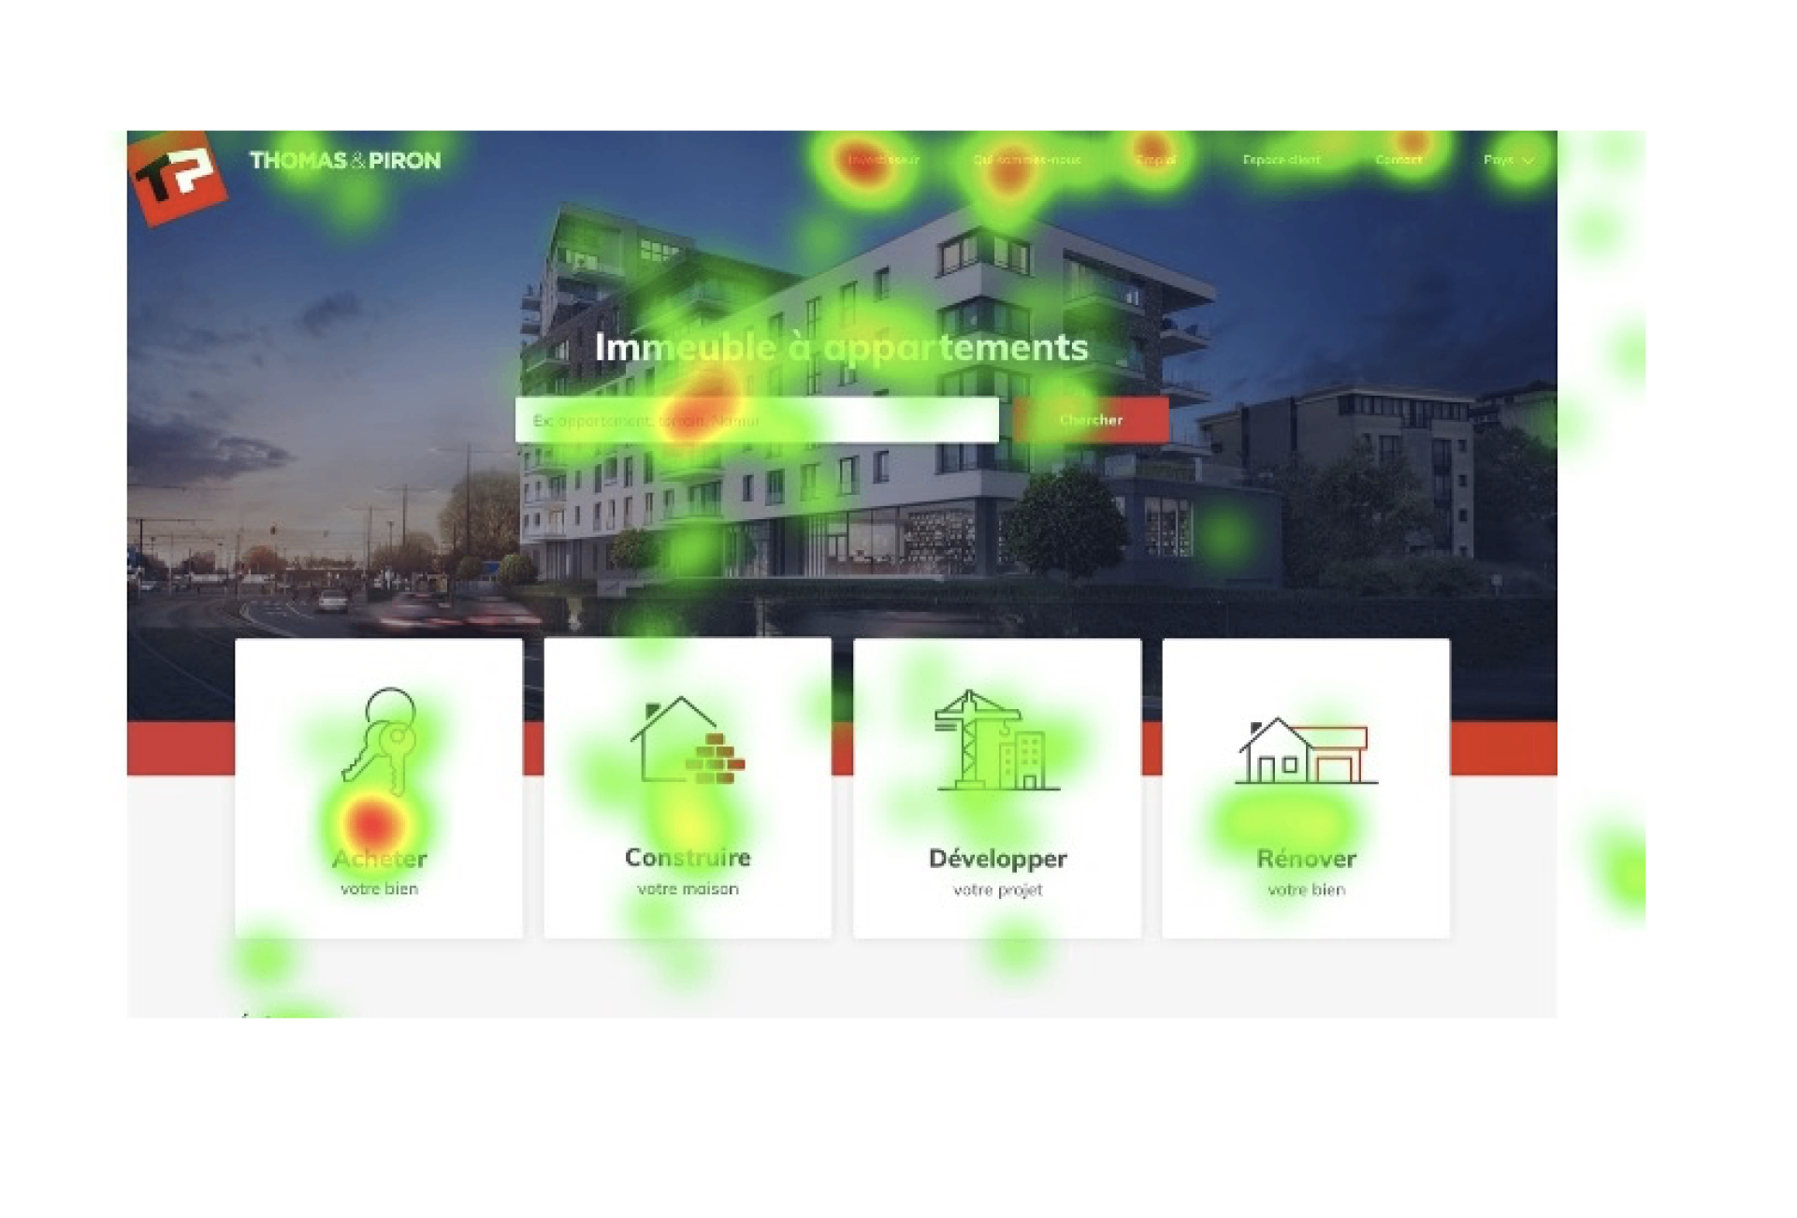
Example : Commented screens
Description
The phrase related to the image and the examples in the search bar brings a lot of confusion to many users, even a feeling of “aggression” that surprises negatively. Some people therefore think that they cannot look for a house.
Recommendation
Show a more general sentence about the value proposition, as well as a photo less focused on a specific product. Stay general, without focusing on a specific product, in the search bar.
Source : JEMS
Notes:
This is another classic slide, but with eye tracking here to stress out the main issue.

Slide 78
Exercise
Exercise time
Write the report and present
Additional resources : https://digital.gov/resources/digitalgov-user-experience-resources/digitalgov-user-experience-program-usability-starter-kit/
Source : JEMS
Notes:
Objective: Summarize and present the results of your test in a clear and actionable way. Instructions:
Write a short test report including:
The tested hypothesis
Who was tested (profile)
The main findings (pain points, positive points)
Your recommendations
Prepare a 3-minute oral presentation to share your results with the group.
Notes for the trainer : Encourage participants to keep the report concise and to focus on the most important findings and actionable recommendations.

Slide 79
What you need to remember – User Testing
User testing is the ultimate method for understanding usage in depth and improving your product through qualitative feedback.
Conducting effective user testing requires preparation and control of your environment.
Conducting a user test means following a test protocol.
User test analysis focuses on recommendation
Notes:
Key lessons from this course

Slide 80
What you need to remember – User Testing
5 mistakes to avoid
Not having a test plan
Recruiting the wrong participants
Not testing early enough
Including too much information
Test to confirm your own ideas
Notes:
Key lessons from this course

Slide 81
Summary
You've just completed a key step in becoming a thoughtful and effective UX designer.
In this lesson, we explored how User Research helps you deeply understand your users — their needs, goals, frustrations, and behaviors.
You learned how to ask the right questions, choose the right research methods, and extract meaningful insights from your findings.
We also dived into Usability Testing, where you observed how real users interact with your designs. You learned how to test early, test often, and iterate based on real feedback — not assumptions.
Together, these skills ensure that your designs are not only beautiful, but useful, usable, and grounded in real-world needs.
Keep putting users first. It’s the heart of great UX.

Slide 82
Evolution of heuristic inspection: towards an integration of accessibility, practicality, emotion and persuasion criteria in ergonomic evaluation (Brangier et al., 2015)
Introducing Usability Heuristics for Mobile Map Applications (Kuparinem, 2013)
Appropriating and Assessing Heuristics for Mobile Computing (Bertini et al. )
A Set Of Heuristics for User Experience Evaluation in E-commerce Websites (Bonastre & Granollers)
Heuristic evaluation for e-Government websites in Saudi Arabia (Eidaroos & al.)

Slide 83
10 heuristics for an Optimal User Experience (Colombo & Pasch)
The evolution of the ergonomics of computer products: accessibility, usability, emotionality and influenceability (Brangier & Bastien)
Development of an analysis grid of persuasive aspects in computer ergonomics (Nemery, Brangier, Kopp)
Development, validation and application of the interactive persuasion criteria grid (Nemery) http://ergoweb.ca/criteres/

Slide 84
ADDITIONAL READING
https://digital.gov/resources/digitalgov-user-experience-resources/digitalgov-user-experience-program-usability-starter-kit/
Usability test software tool: Excel data logger
Body Language: Understanding Nonverbal Communication | Science of People

